Slide 1

Battle of Neighborhoods
* Redmond vs Seattle

Slide 2
Objective
Collecting Neighborhood’s top trending venues using Foursquare API
Forming neighborhood clusters
Identifying and understanding the similarities and dissimilarities.

Slide 3
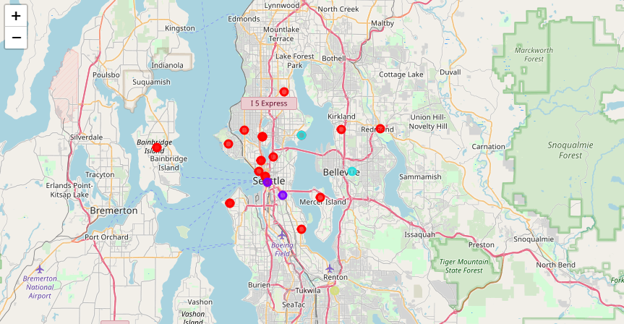
Figure 1: Folium Map of Seattle Neighborhoods and Clusters

Slide 4
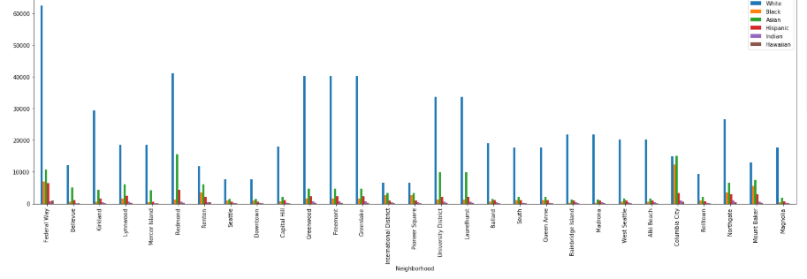
Figure 2. Population Distribution

Slide 5
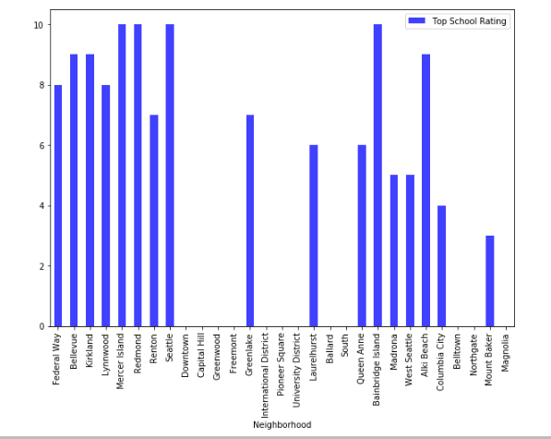
Figure 3. School Ratings

Slide 6
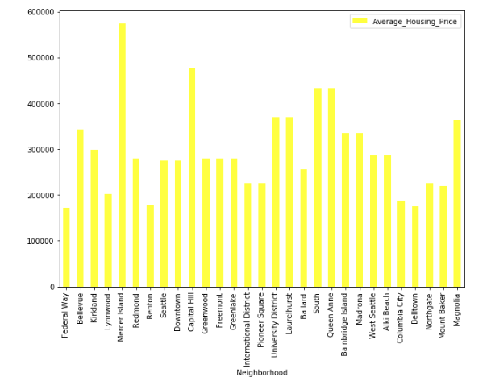
Figure 4. Housing Price

Slide 7
Redmond vs Seattle

Slide 8
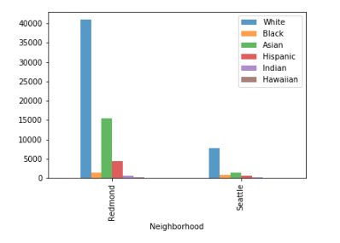
Figure 5. Population Distribution

Slide 9
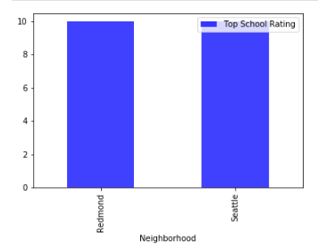
Figure 6. School Ratings

Slide 10
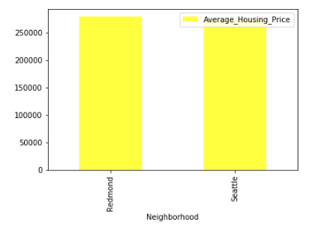
Figure 7. Housing Price

Slide 11

Conclusion
Redmond has the higher number of Hispanic people.
Redmon and Seattle have same number of top schools.
Redmond has higher housing price.

